Slide 1
Vi editor (visual editor)
The default editor that comes with the UNIX operating system is called Vi.
It is user-friendly and works same on different platforms.
It is a very powerful application. An improved version of vi editor is vim.
The vi editor commands are case sensitive
The vi editor has two modes:
Command mode −
This mode enables you to perform administrative tasks such as saving the files, executing the commands, moving the cursor, cutting (yanking) and pasting the lines or words, as well as finding and replacing.
Insert mode −
This mode enables you to insert text into the file. The Esc key will take you to the command mode from insert mode.
By default, the vi editor starts in command mode. To enter text, you have to be in insert mode, just type 'i' and you'll be in insert mode. Although, after typing i nothing will appear on the screen but you'll be in insert mode. Now you can type anything.
To exit from insert mode press Esc key, you'll be directed to command mode.

Slide 2
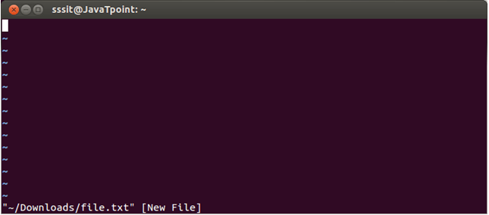

Example:
vi /home/sssit/Downloads/file.txt
$ vi filename.sh
Command mode
This is what you'll see when you'll press enter after the above command. If you'll start typing, nothing will appear as you are in command mode. By default vi opens in command mode.

Slide 3
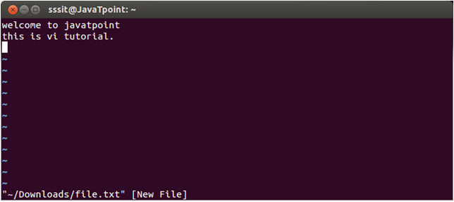
Insert mode
To move to the insert mode press i. Although, there are other commands also to move to insert mode

Slide 4
To save and quit
You can save and quit vi editor from command mode. Before writing save or quit command you have to press colon (:). Colon allows you to give instructions to vi.
Commands | Action
:wq | Save and quit
:w | Save
:q | Quit
:w fname | Save as fname
ZZ | Save and quit
:q! | Quit discarding changes made
:w! | Save (and write to non-writable file)

Slide 5
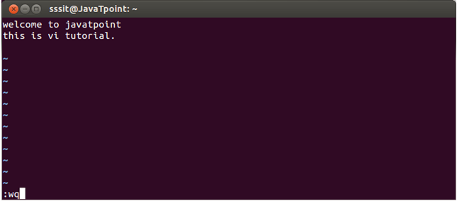
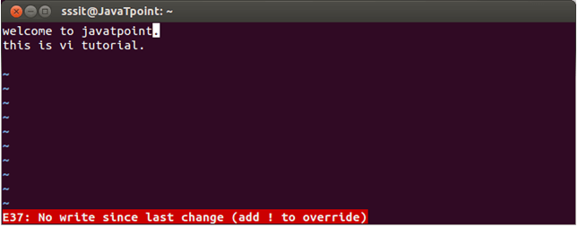
To exit from vi, first ensure that you are in command mode. Now, type :wq and press enter. It will save and quit vi.
Type :wq to save and exit the file.
If you want to quit without saving the file, use :q. This command will only work when you have not made any changes in the file.

Slide 6
Vi Commands
Linux vi editor is different from other editors. You have to use different keys to use different functions. Although, it's quite easy and interesting to use vi editor.
Have a look at the vi commands in the following table.
To switch from command to insert mode:
Command | Action
i | Start typing before the current character
I | Start typing at the start of current line
a | Start typing after the current character
A | Start typing at the end of current line
o | Start typing on a new line after the current line
O | Start typing on a new line before the current line

Slide 7
To move around a file:
To jump lines
Commands | Action
j | To move down
k | To move up
h | To move left
l | To move right
Commands | Action
G | Will direct you at the last line of the file
`` | Will direct you to your last position in the file

Slide 8
To delete:
Commands | Action
x | Delete the current character
X | Delete the character before the cursor
r | Replace the current character
xp | Switch two characters
dd | Delete the current line
D | Delete the current line from current character to the end of the line
dG | delete from the current line to the end of the file

